Slide 1



[Github Intro]

Slide 2

Some tips you must know…

Slide 3
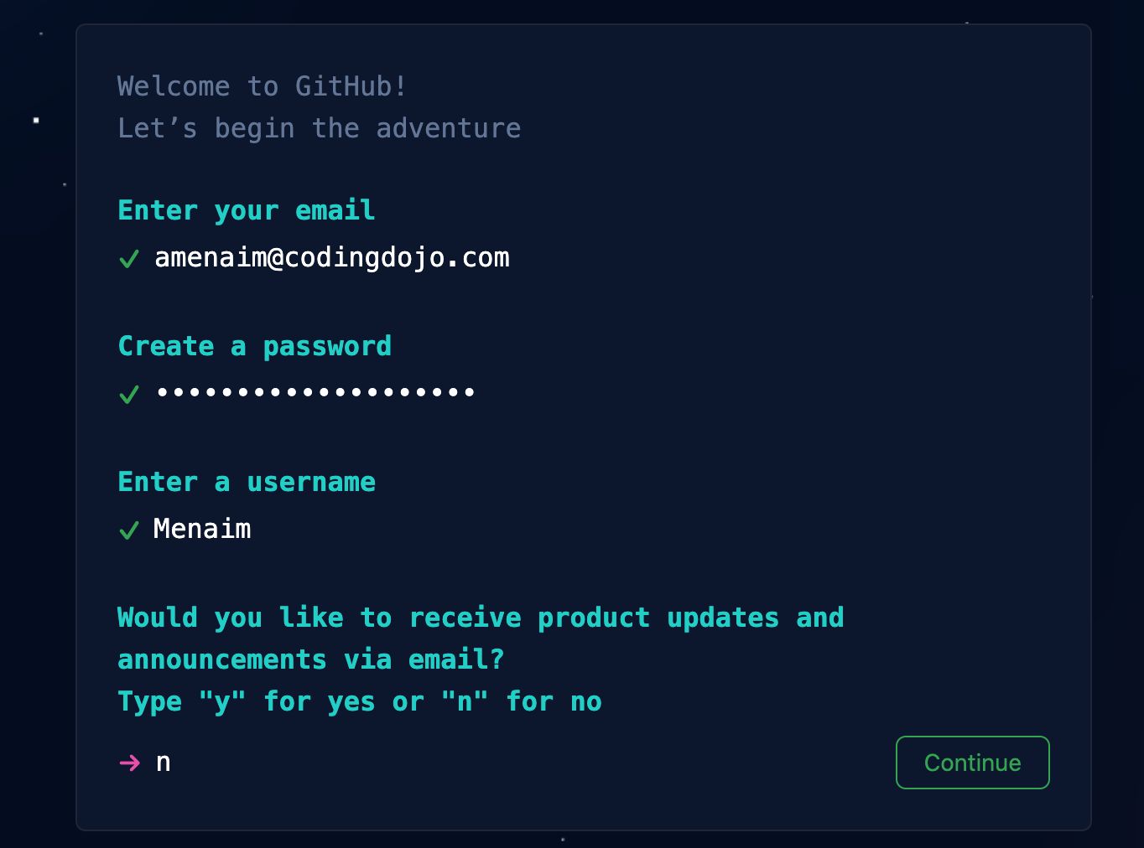
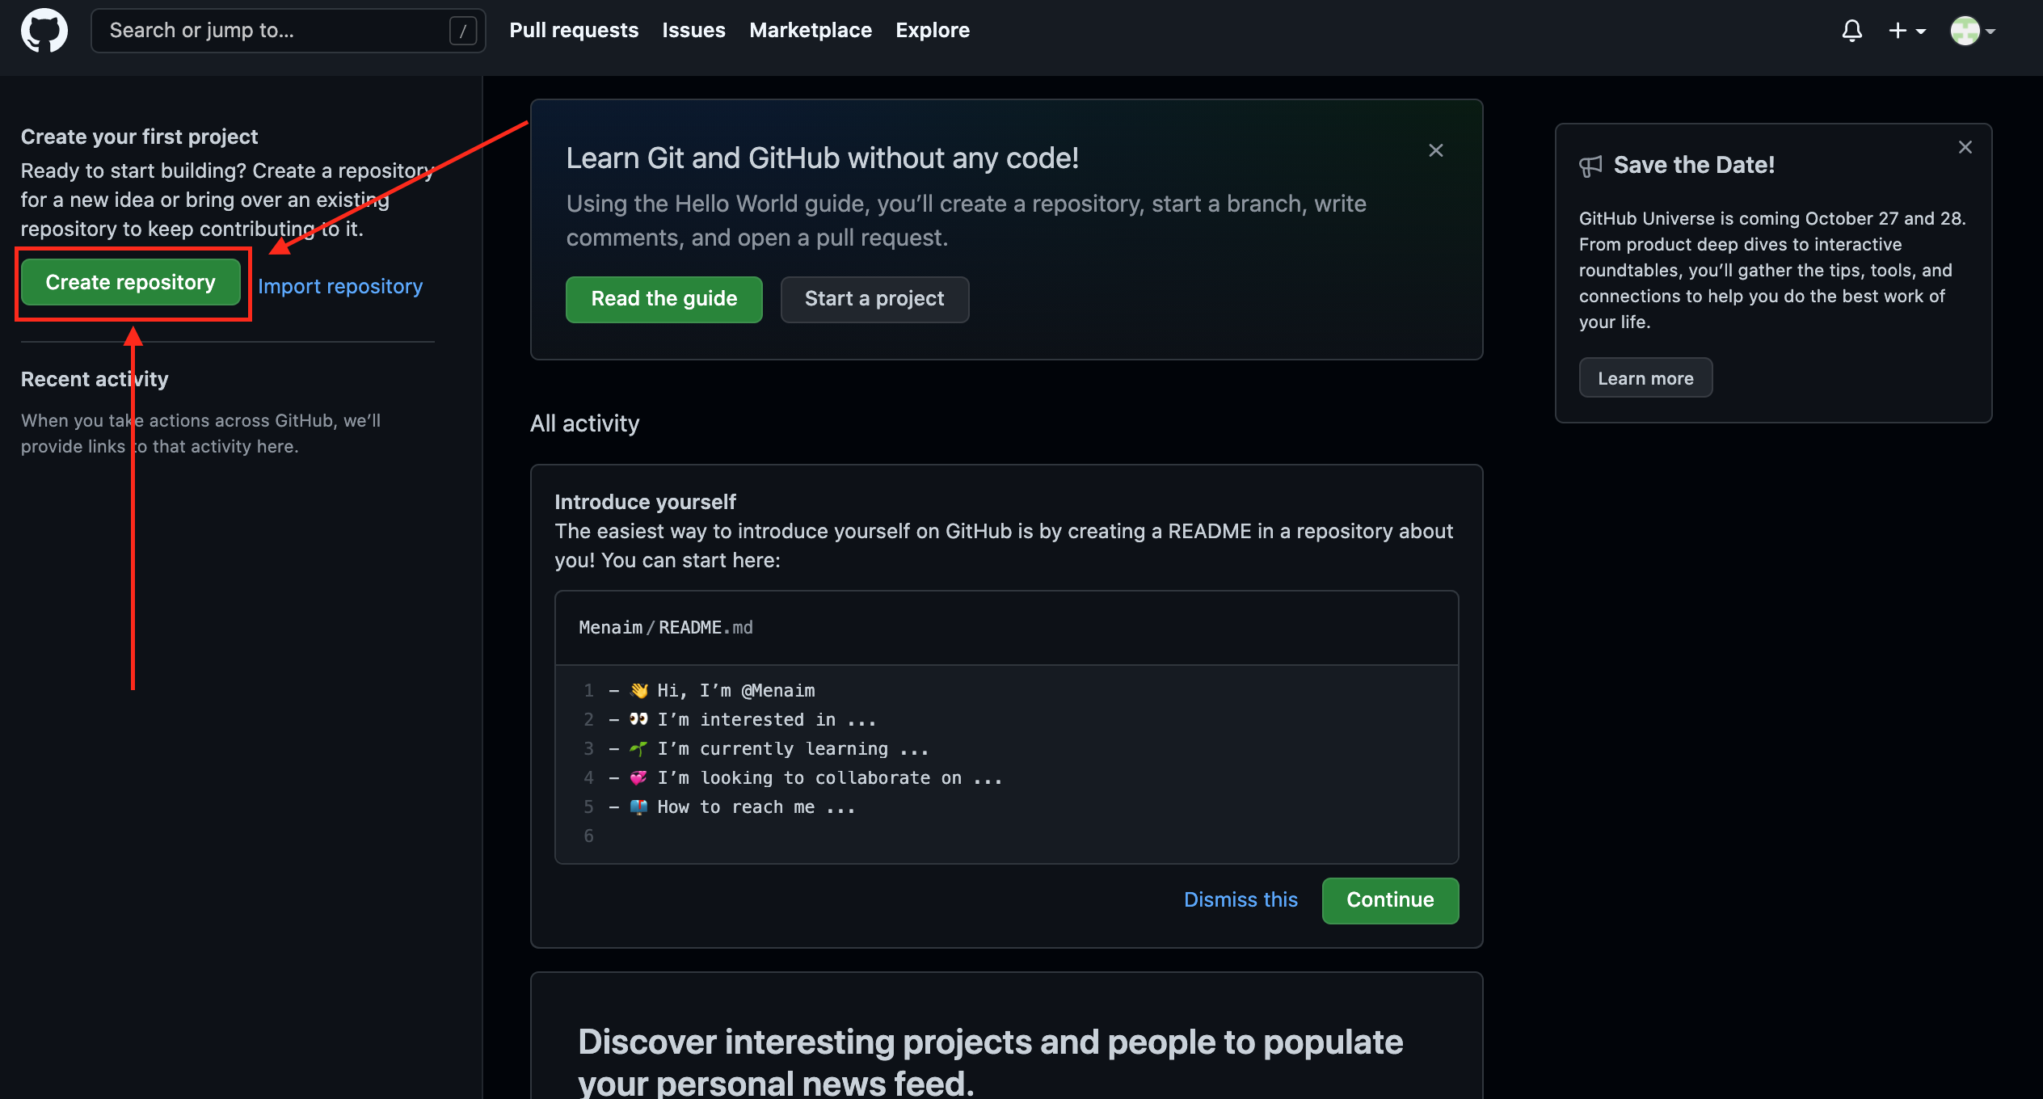
Signup & Login
1- Sign up from here
2- Fill your data
3- Yopy!! You are in the dashboard now
4- Click on create repository

Slide 4
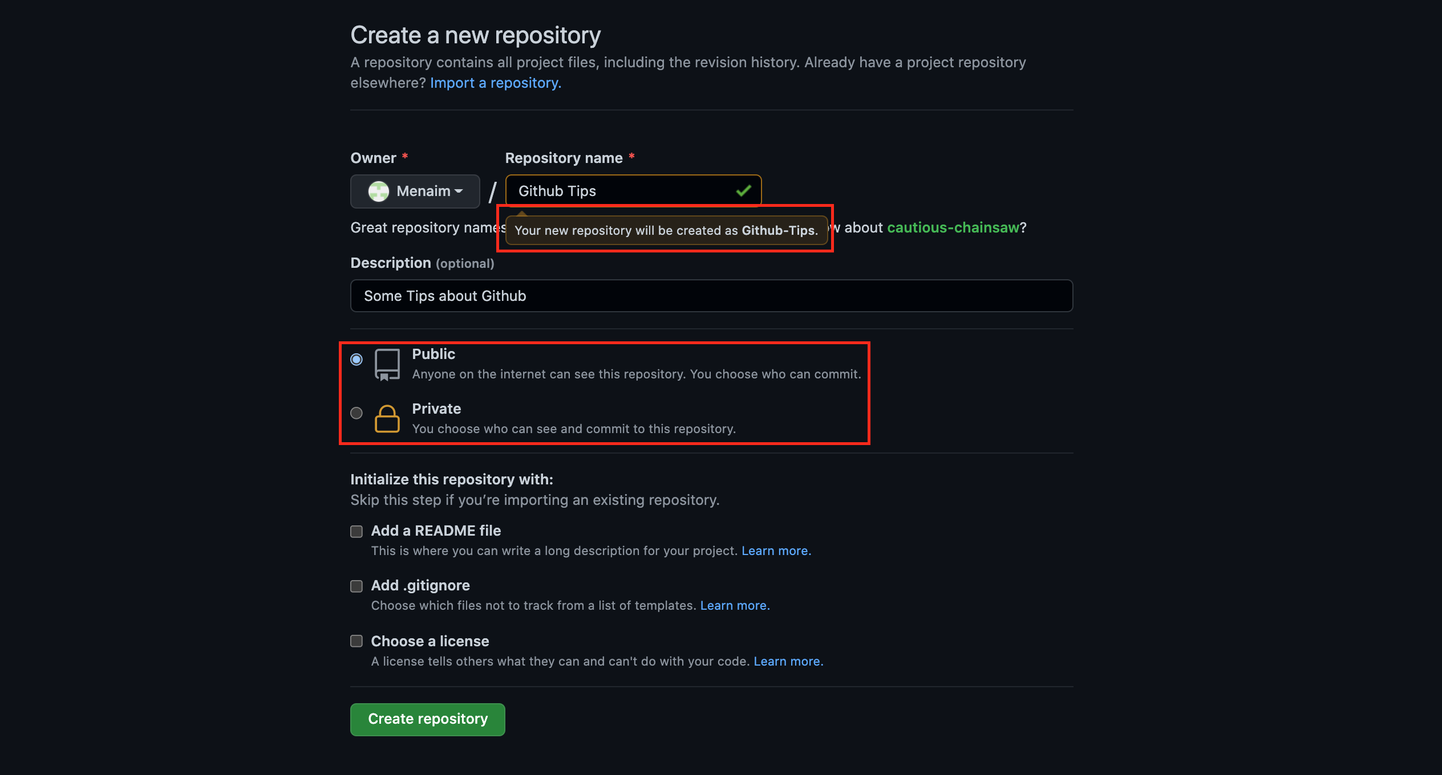
Creating Repo Tips
1- Repository name can’t have spaces
2- You can make it private and share it with your team only “Recommended for private work
3- You can make it public for anyone to see

Slide 5
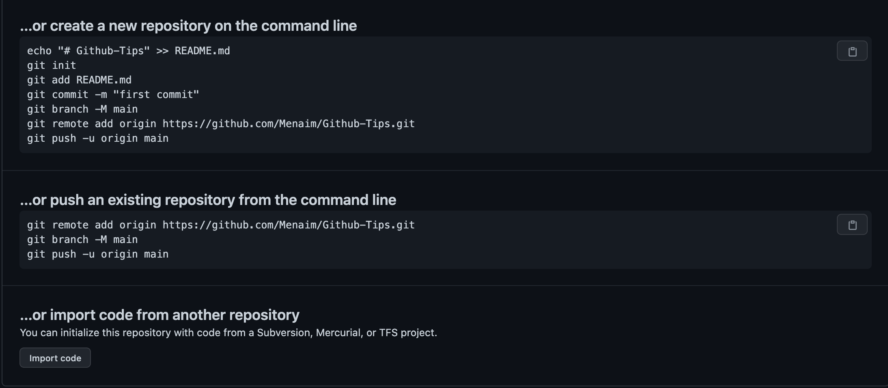
Creating Repo Tips Cont.
Don’t worry !! Every single line will be explained
1- Once you click on create you will see this screenshot…

Slide 6
Creating Repo Tips Cont.
1- You need to access the file in your PC by doing this:
1.1 Open terminal
1.2 Drag the folder

Slide 7

You did it!
Congratulations [Program Name] Cohort of [Month] [Year]!
You’ve worked hard to get here. Before we leave, we want to remind you what you’ve accomplished.

Slide 8

Presentations You’ve Given
[#]

Slide 9

[Deliverables/
Projects] You’ve Created
[#]

Slide 10

Tools You’ve Used
[Tool/Skill]
[Tool/Skill]
[Tool/Skill]
[Tool/Skill]
[Tool/Skill]
[Tool/Skill]
[Tool/Skill]
[Tool/Skill]
[Tool/Skill]
[Tool/Skill]
[Tool/Skill]
[Tool/Skill]
[Tool/Skill]
[Tool/Skill]
[Tool/Skill]
[Tool/Skill]
[Tool/Skill]
[Tool/Skill]
[Tool/Skill]
[Tool/Skill]
[Tool/Skill]
[Tool/Skill]
[Tool/Skill]
[Tool/Skill]

Slide 11

Total Customers You Interviewed
[#]
Interviews
[#]
Survey Responses

Slide 12

Companies You’ve Learned From
[Company]
[Company]
[Company]
[Company]
[Company]
[Company]
[Company]
[Company]
[Company]

Slide 13

Assignments You’ve Completed
[#]

Slide 14

Other (random) things we’ve learned
[Funny things from class, optional]

Slide 15
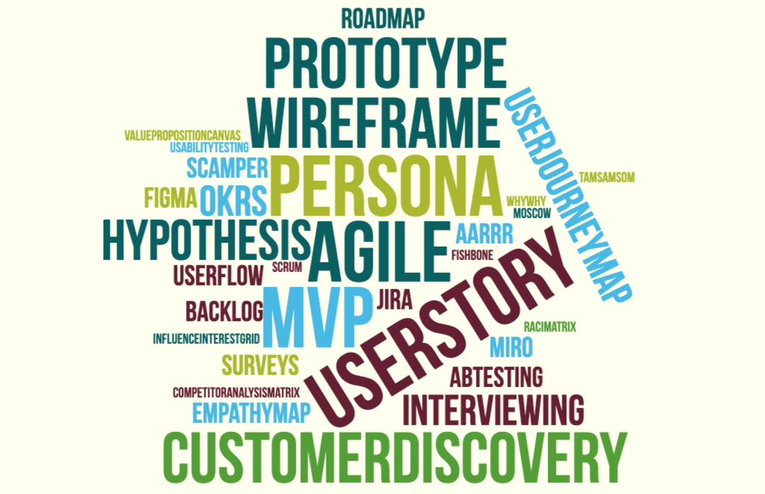

Slide 16
[Program Name]
[Month] [Year] Cohort

Slide 17


[First Last]
-[Job Title]-
“[Quote from teammates about this person, instructor/TA praise, or achievements from class”

Slide 18
[First Last]
-[Job Title]-
“[Quote from teammates about this person, instructor/TA praise, or achievements from class”

Slide 19
[First Last]
-[Job Title]-
“[Quote from teammates about this person, instructor/TA praise, or achievements from class”

Slide 20
[First Last]
-[Job Title]-
“[Quote from teammates about this person, instructor/TA praise, or achievements from class”

Slide 21
[First Last]
-[Job Title]-
“[Quote from teammates about this person, instructor/TA praise, or achievements from class”

Slide 22
[First Last]
-[Job Title]-
“[Quote from teammates about this person, instructor/TA praise, or achievements from class”

Slide 23
[First Last]
-[Job Title]-
“[Quote from teammates about this person, instructor/TA praise, or achievements from class”

Slide 24
[First Last]
-[Job Title]-
“[Quote from teammates about this person, instructor/TA praise, or achievements from class”

Slide 25
Keep in touch!

Slide 26

Really, we mean it.
We’d love to hear about how things are going, especially about any jobs or other career milestones.
A few months after the cohort finishes, we’ll also send you a survey to check in and see how things are going.
Feel free to connect with all of us on LinkedIn!

Slide 27

Final Notes
You have access to the Learn Platform for one year after graduation.
If you want access after that, you can purchase an alumni pass.
If you met all the graduation requirements, your certificate will be emailed to you later today. If you do not receive one and think you should, please email us.
[Additional notes]

Slide 28
Thank you
For being an amazing cohort.
We’ll miss you! Good luck!

